Slide 1

Does the car you drive affect Air Quality?
Celeste Muniz-Lithgow
Deepa Vadakan
Palak Soni
Tim Samson

Slide 2

Air Quality
Air Quality affects the air we breathe and our overall health. One of the major factors of reducing air quality is related to elevated levels of ozone and particulate matter.
Ozone and particulate matter from vehicles is one of the sources of these pollutants.

Slide 3
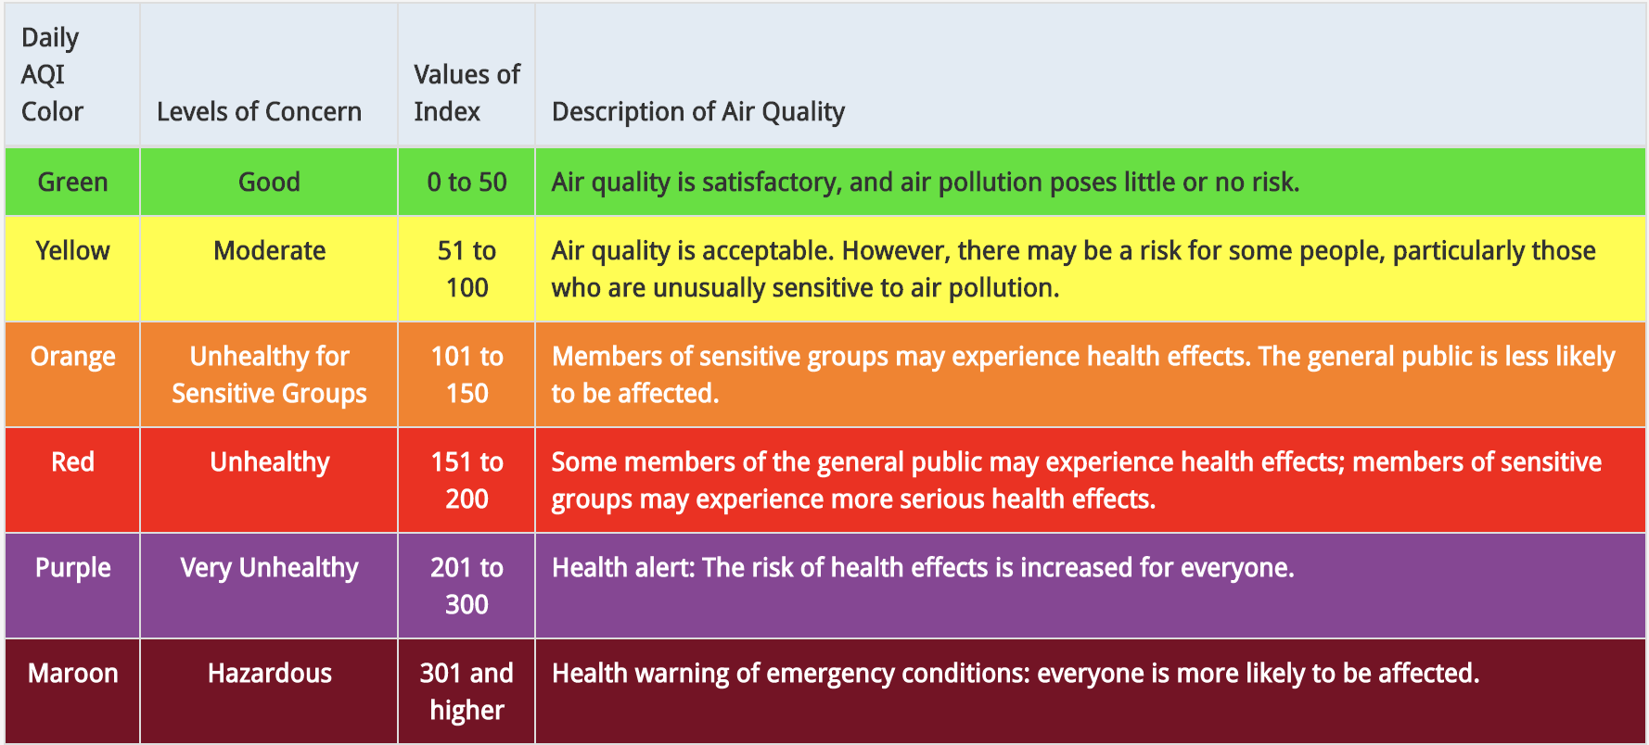
Air Quality Index

Slide 4
Hypothesis: There is a correlation between vehicles and the air we breathe.
Questions
Does the density of cars in a particular area affect air quality?
Does the age of cars affect air quality?
Does the type of car affect air quality?
Is a hybrid/electric car more beneficial to our health?

Slide 5



Source
Vehicle, Snowmobile, and Boat Registrations from data.ny.gov
AQI Index from airnowapi.org
Zip code coordinates from Public.Opendatasooft.com

Slide 6
Challenges
Huge size of the vehicle data from data.ny.gov. Over 11 million records.
Limits on the API call to retrieve Air Quality Index from AirNow. Limit of 500 requests per hour.
Air Quality Index not available on AirNow prior to 2009.
We limited ourselves to 3 years worth of Air Quality Index data: 2009, 2015 and 2020.

Slide 7
Data Cleanup & Exploration

Slide 8

Data Analysis

Slide 9
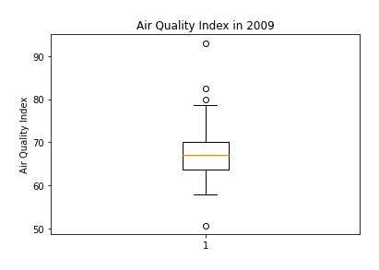
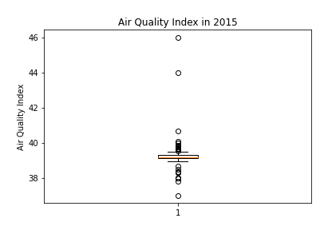
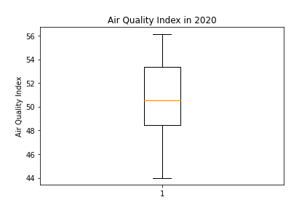
Comparing Air Quality Index for 2009, 2015 and 2020
The Air Quality Index in 2009 had a median of 68 with a few outliers.
2015 was a strange year, with a median Air Quality Index of 39 which is a significant drop. However, this year had many outliers.
In 2020, the median Air Quality Index was around 50 which is an increase from the anomaly year 2015 and decrease from 2019.
Overall, the Air Quality has improved from 2009 to 2020.

Slide 10
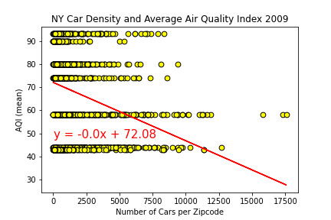
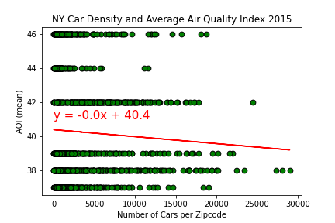
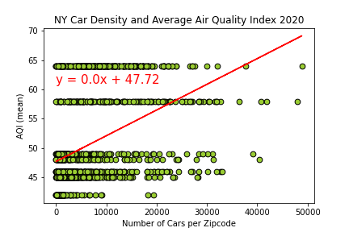
Does the density of cars in a particular area affect air quality?
Here we are comparing the Air Quality Index based on density of cars by zipcode.
The following scatter plots for years 2009, 2015 and 2020 show that density of cars in a given area does not have a correlation to the average Air Quality Index.
NY Car Density and Average Air Quality Index 2009, 2015 and 2020

Slide 11
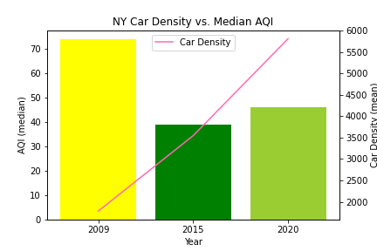
New York Car Density vs. Median AQI
Here we are comparing the Median Air Quality Index for 2009, 2015 and 2020 to car density.
The colors of each bar correspond to Air Quality Index color gradient. Yellow = Moderate, Green = Good.
Once again, we see that increased car density over the last decade has no affect on AQI.

Slide 12
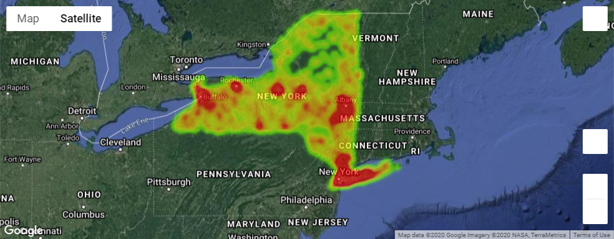
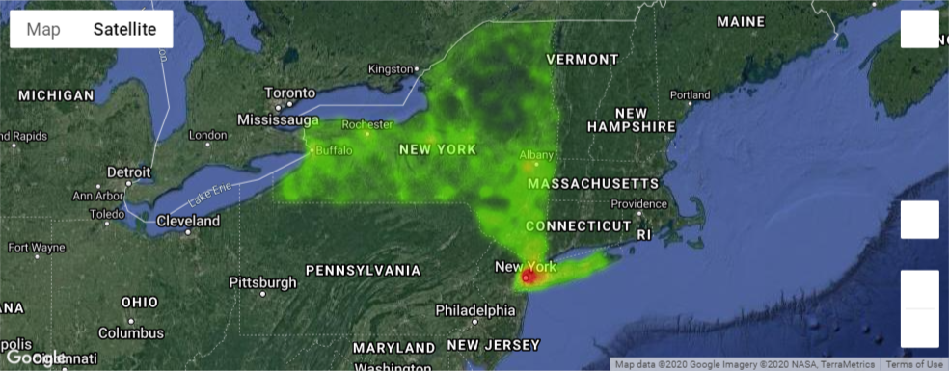
Comparing Air Quality Index and Car Age for 2009
AQI
Car Age

Slide 13
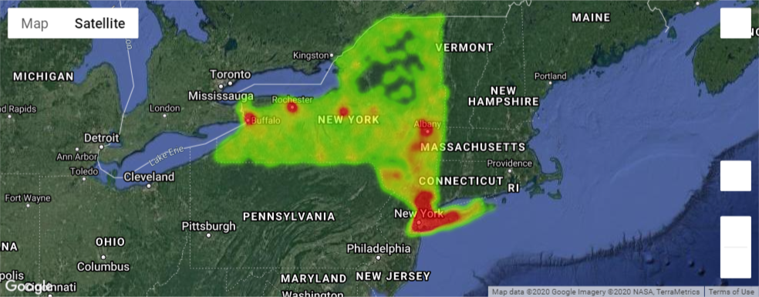
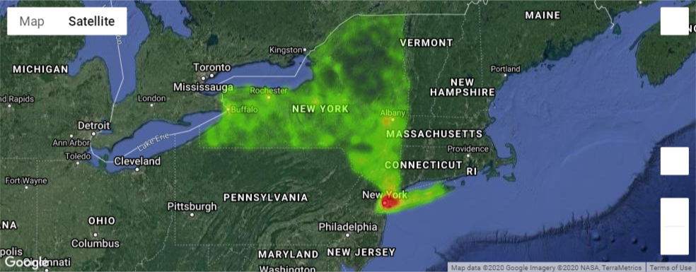
Comparing Air Quality Index and Car Age for 2015
AQI
Car Age

Slide 14
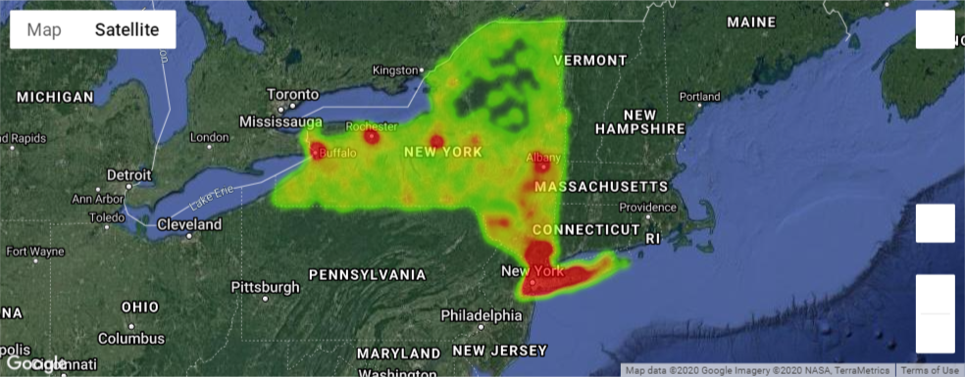
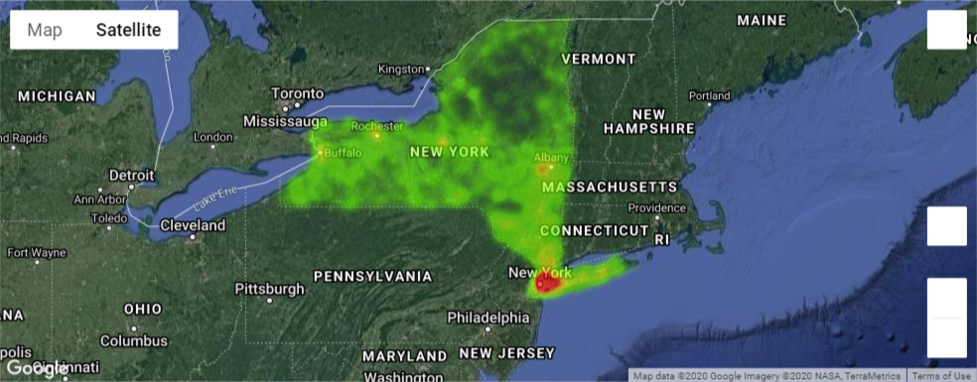
Comparing Air Quality Index and Car Age for 2009
AQI
Car Age
2020

Slide 15
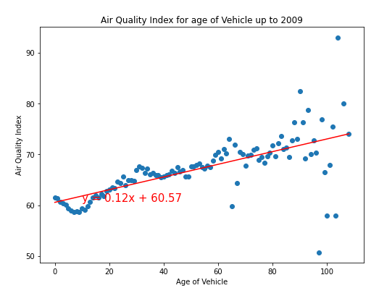
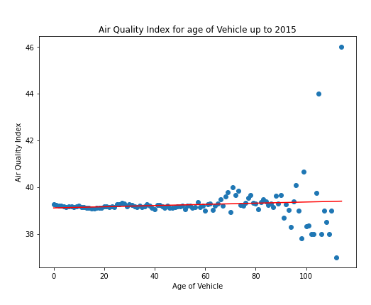
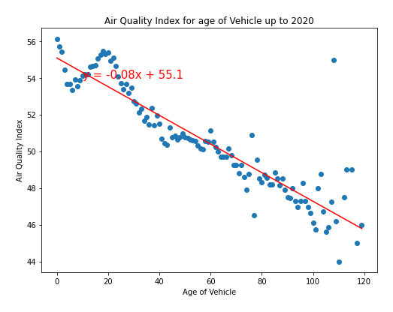
Air quality Index vs Age of Vehicles for 2009, 2015 and 2020
Here we are comparing the Air Quality Index based on the age of the cars by zipcode.
In 2009, the scatter plot shows that the Air Quality was better in areas with newer cars than with older cars.
In 2015, the scatter plot does not show much difference in the air quality index. Though, there was a wide range of Air Quality Index values for older cars.
In 2020, the Air Quality Index dropped for areas that have older cars. This may be because they are not in use as much or these cars are slowly being phased out.

Slide 16
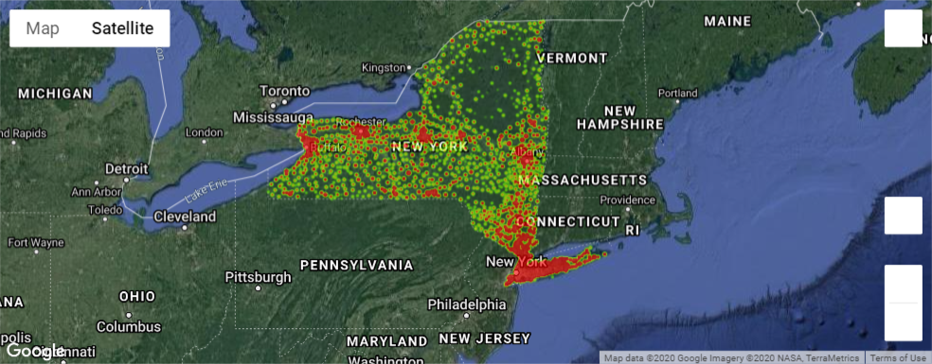
Comparing Air Quality Index and Number of Cars for 2009
AQI
Total Cars

Slide 17
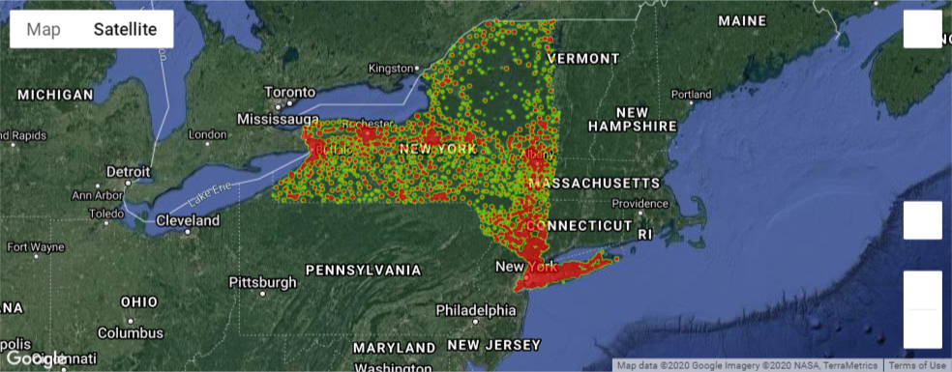
Comparing Air Quality Index and Number of Cars for 2015
AQI
Total Cars

Slide 18
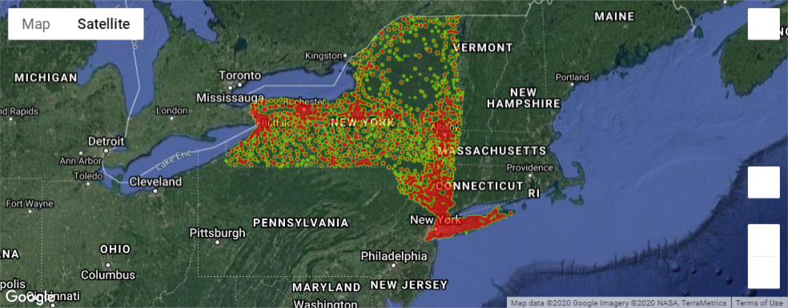
Comparing Air Quality Index and Number of Cars for 2020
AQI
Car Age
Total Cars
2020

Slide 19
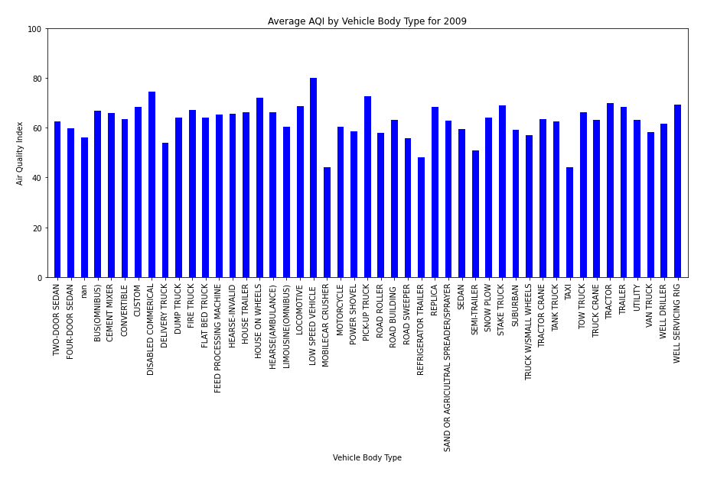
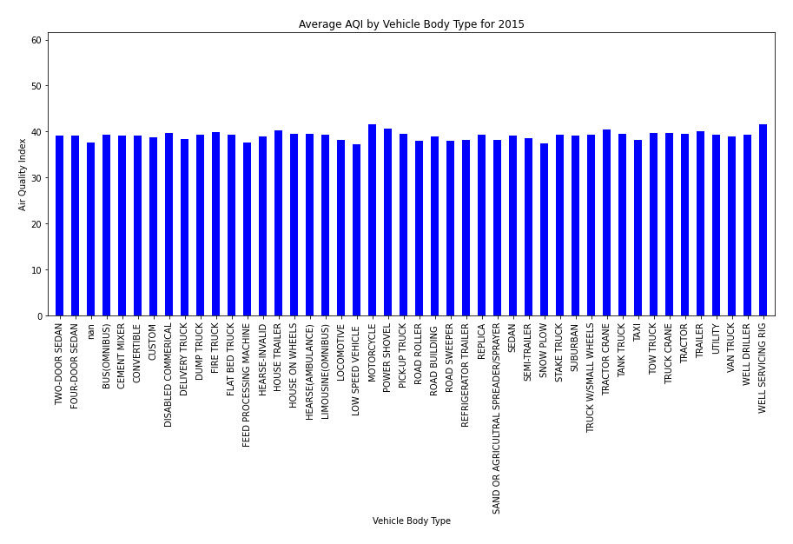
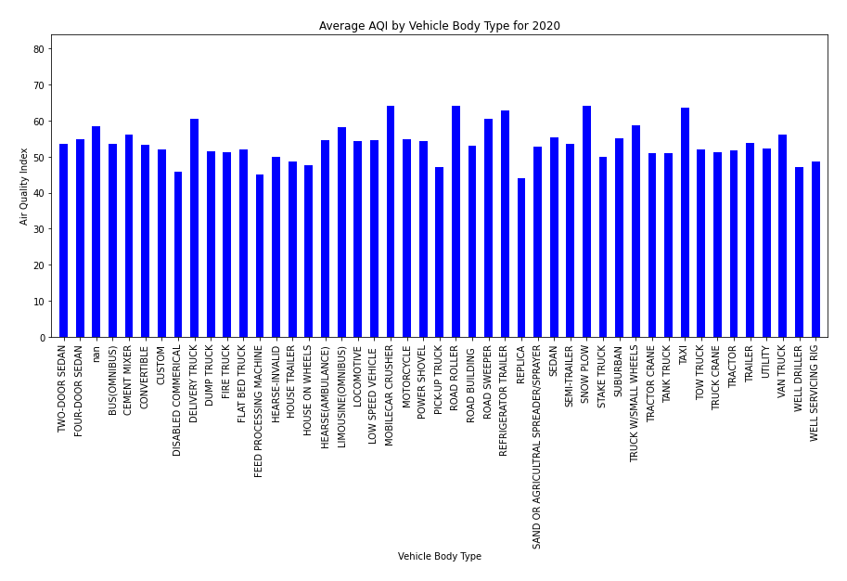
Air Quality Index per Body Type for 2009, 2015 and 2020
There does not seem to be any difference in the type of car and the Air Quality.

Slide 20
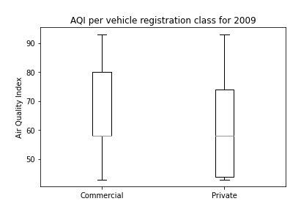
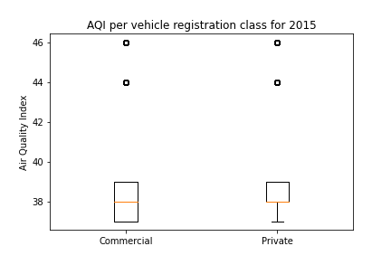
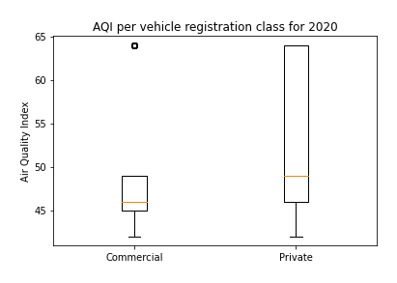
Air Quality Index for Private vs Commercial cars
In 2009, areas with more commercial vehicles had a higher Air Quality Index which means poorer air quality.
In 2015, the air quality between commercial and private vehicles was almost the same.
In 2020, the air quality in areas with private vehicles was more than those with commercial vehicles.

Slide 21
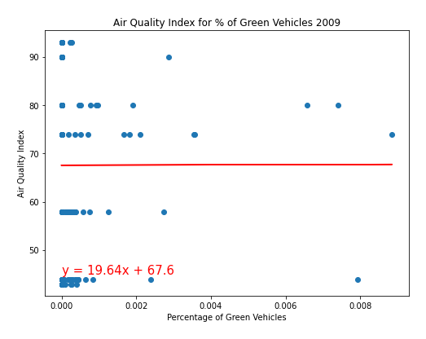
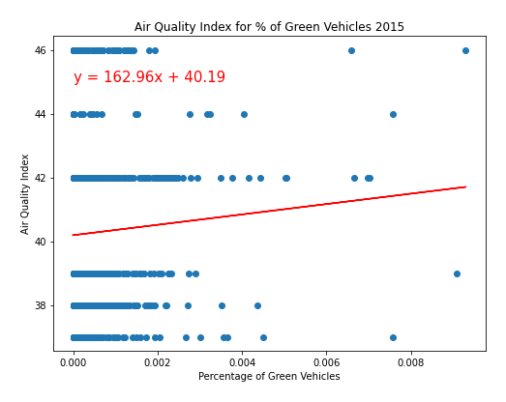
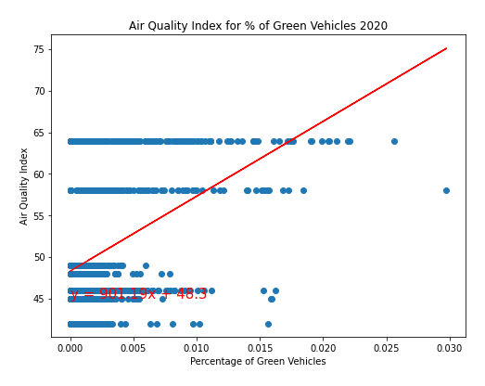
Air Quality Index vs. ”Green” Electric/Hybrid Vehicles.
Given the low r- squared values:
2009 - 2.2896326595606945e-07
2015 - 0.0018160267526019039
2020 - 0.16217576809651804
There is no Correlation between AQI index and the number of “Green” vehicles in a zip code area.

Slide 22
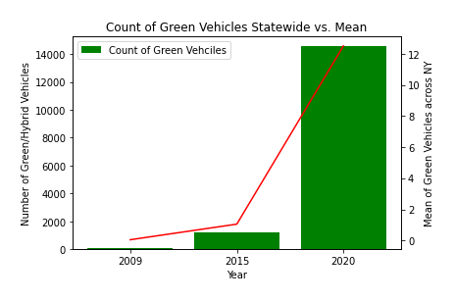
Comparison of ”Green” Vehicle Counts and NY Statewide Mean
Using our 3 datasets it is evident that both the number of “Green” vehicles in the state and the mean (average numbers of green vehicles per zip code within the state) have increased dramatically.
Green Vehicles ownership
From a low of 70 statewide in 2009 to 14,455 in 2020
Mean has increased from .04 to 12.51

Slide 23
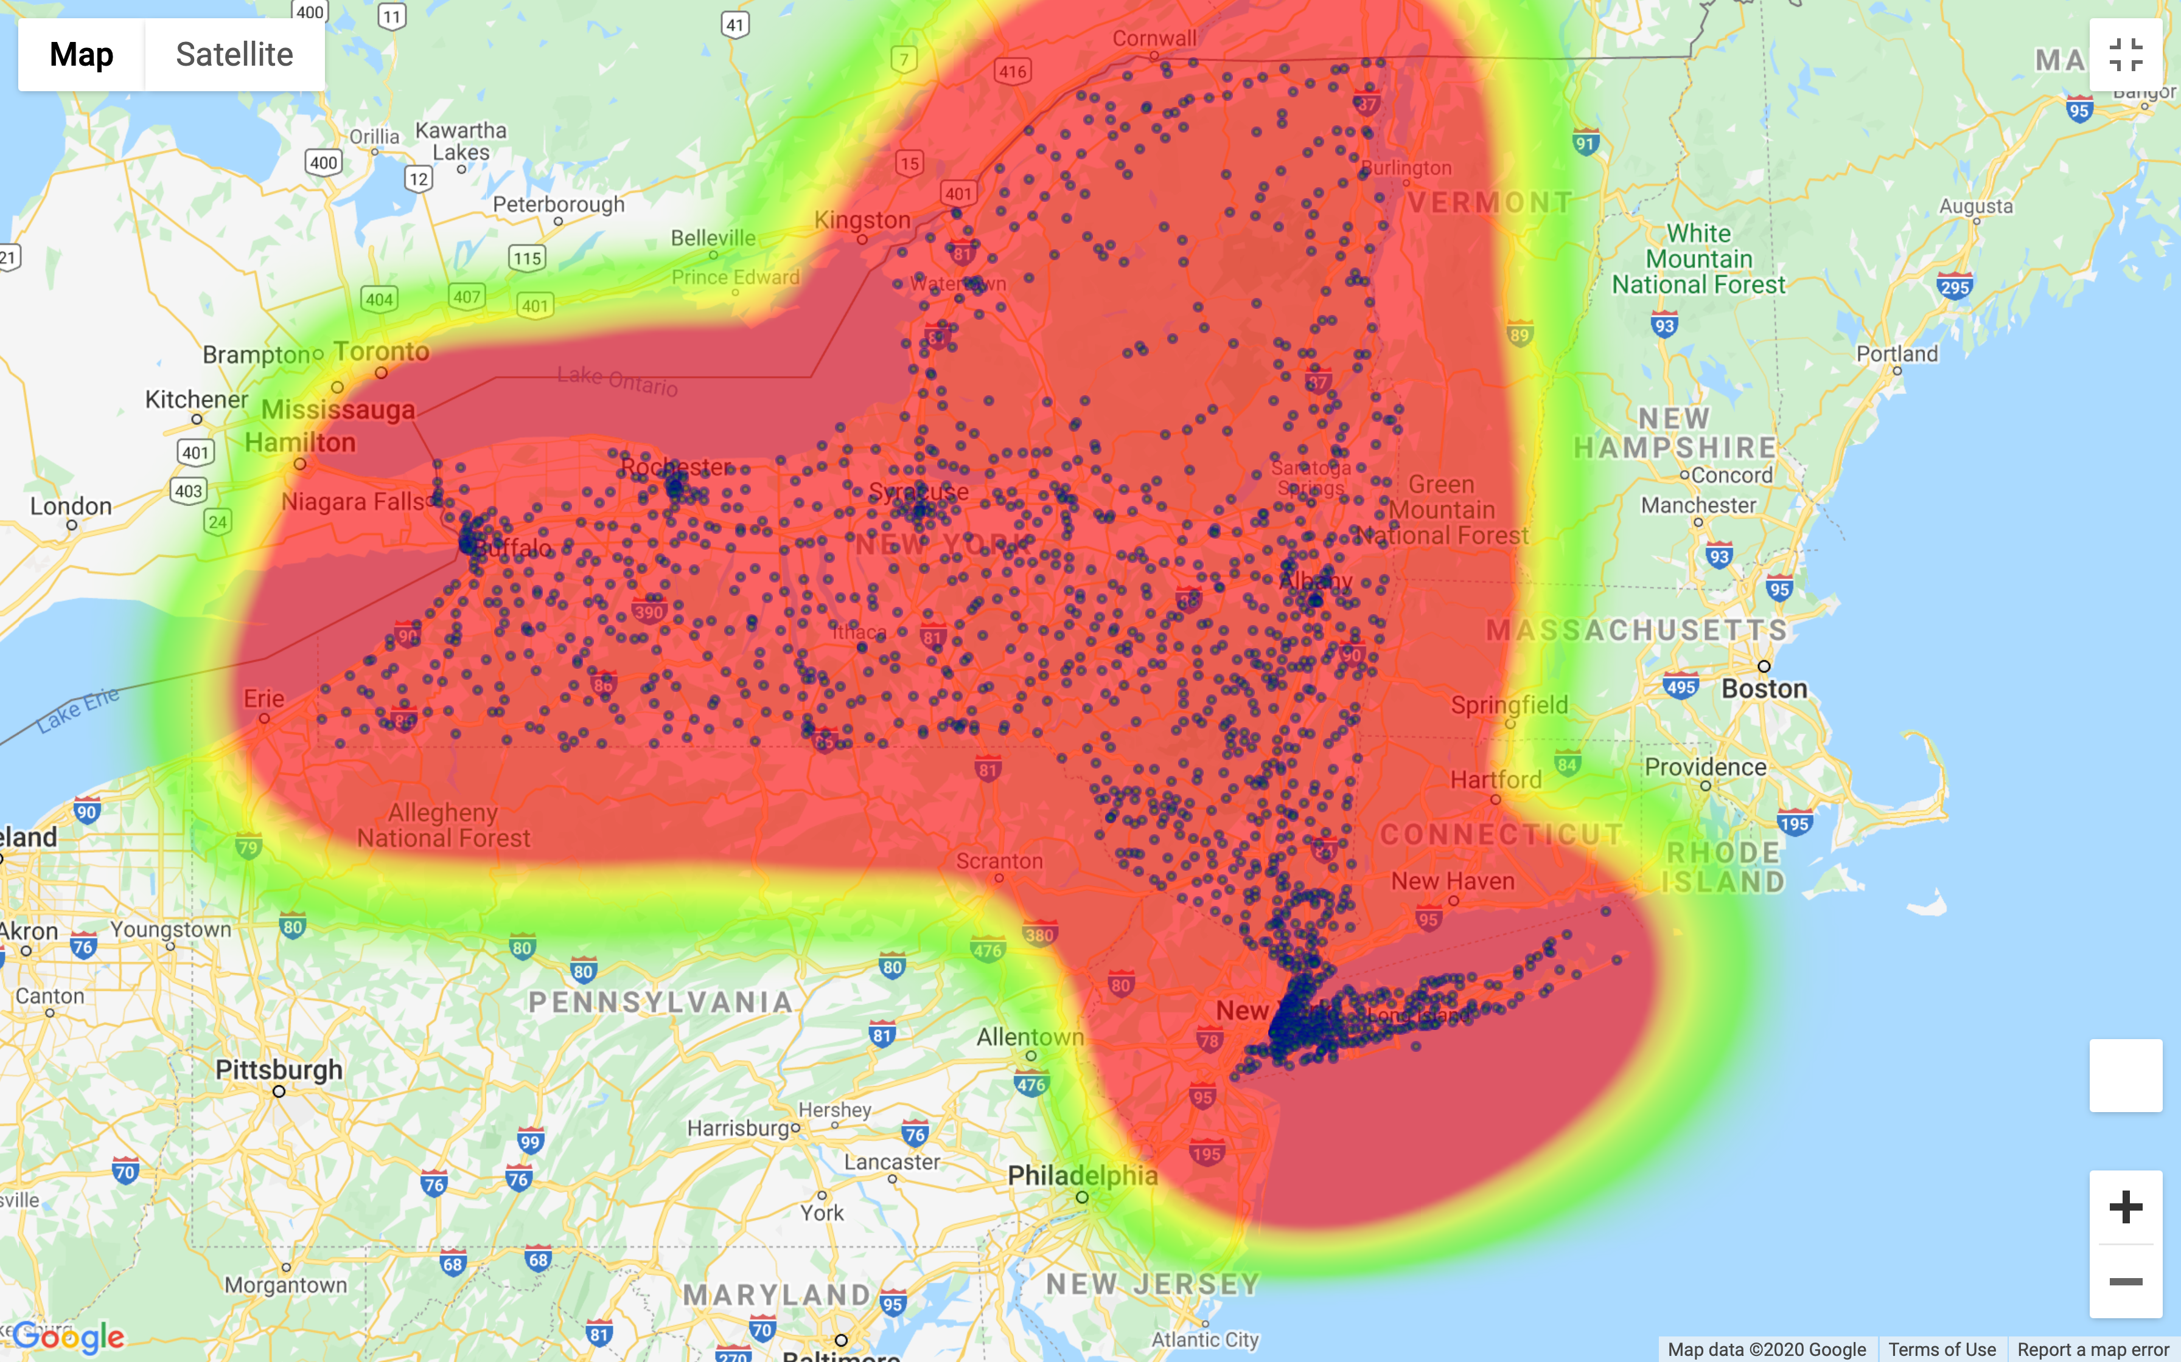
Distribution of ”Green” vehicles in relation to AQI 2009
Vehicle density of “Green” vehicles is greatest in Urban areas vs. rural.
Ownership if “Green” vehicles appears to have little impact on AQI

Slide 24
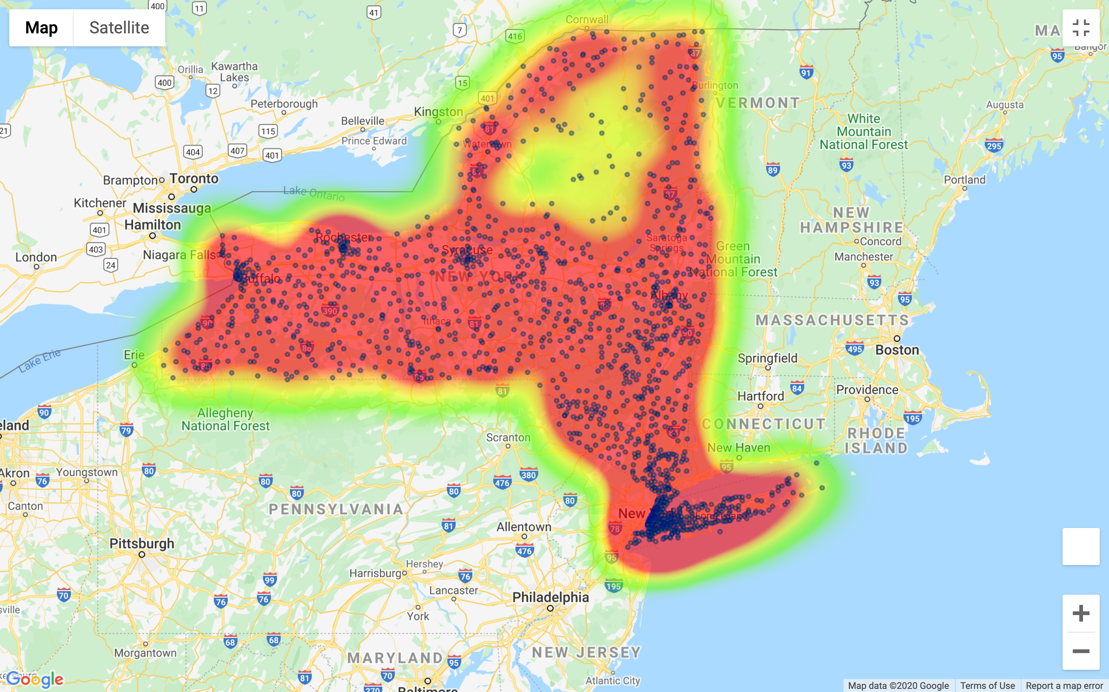
Distribution of ”Green” vehicles in relation to AQI 2015
Vehicle density of “Green” vehicles continues to be greatest in Urban areas vs. rural.
Ownership if “Green” vehicles appears to have little impact on AQI
AQI appears to be getting better.
Larger indicators for vehicle locations indicate larger number of vehicles in that zip.
We see an increase in number of total “Green” vehicles overall in the state.

Slide 25
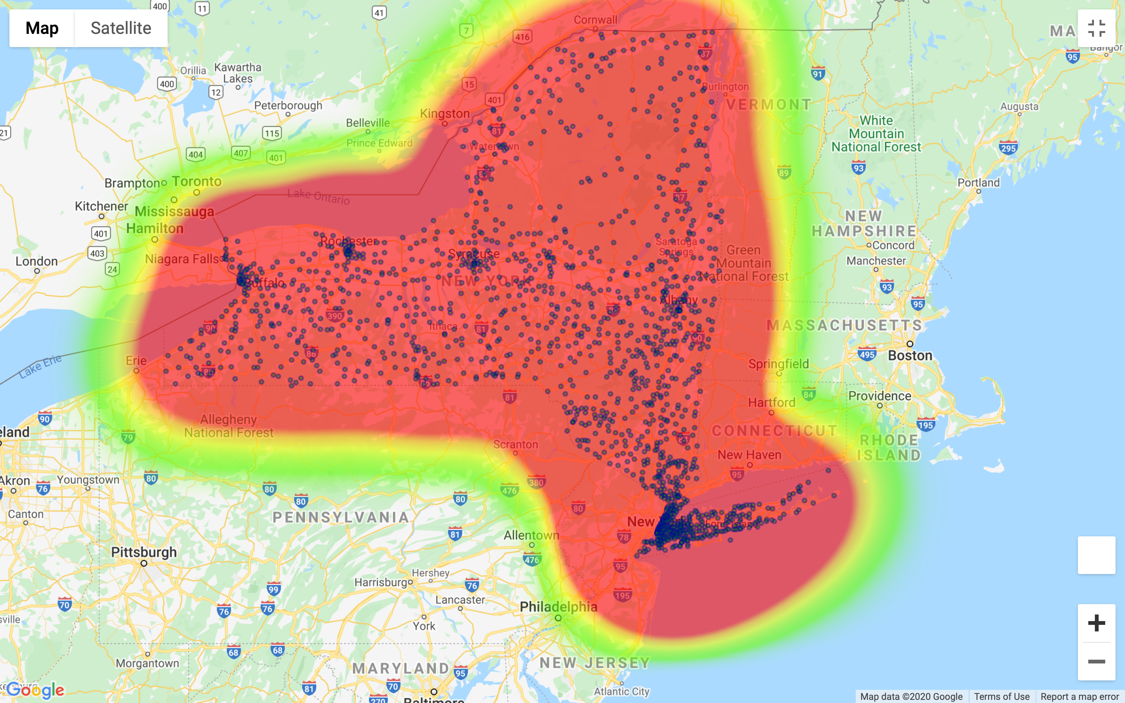
Distribution of ”Green” vehicles in relation to AQI 2020
Vehicle density of “Green” vehicles continues to be greatest in Urban areas vs. rural.
Ownership if “Green” vehicles appears to have little impact on AQI
AQI diminishes for some unknown factor.
Continued increase in number of total “Green” vehicles overall in the state.

Slide 26
Conclusion

